Slide 1

Advanced ML Model
Prepared by: khaled Almir
Supervisor: Dr. Natasha Alkhatib
Position: AI Red team intern at VersifAI

Slide 2
Neural networks
Neural networks are a family of model architectures designed to find nonlinear patterns in data
During training of a neural network, the mode automatically learns the optimal feature crosses to perform on the input data to minimize loss.
Neural networks simplify nonlinear problem-solving.

Slide 3

Nodes and hidden layers
Adding Hidden Layers
  Hidden layers: layers between input and output layers
  Neurons: nodes in hidden layers
  Each neuron behaves like a mini linear model:
  $y^{′}=b+w_{1}x_{1}+w_{2}x_{2}+w_{3}x_{3}$

Slide 4
Neuron operation:
Takes inputs from the previous layer
Multiplies each input by a weight
Adds a bias
Produces an output
Output layer uses hidden neuron outputs as its inputs
Effect: allows the network to learn nonlinear relationships

Slide 5
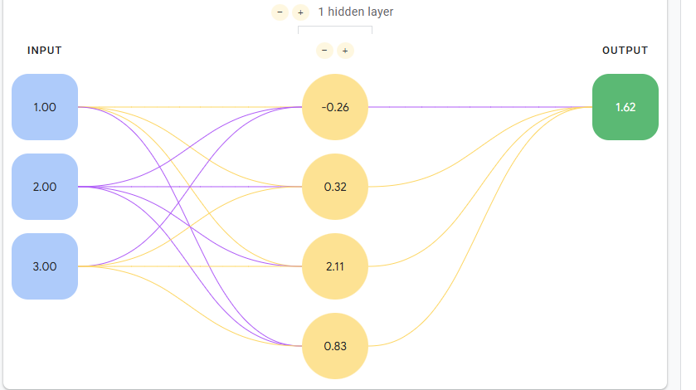
Neural Network Structure

Slide 6
Activation functions
Linear operations on linear outputs are still linear
Need nonlinear mathematical operations to model complex relationships

Slide 7
Common Activation Functions
Sigmoid
Tanh (Hyper bolic Tangent)
ReLU (Rectified Linear Unit)

Slide 8
Sigmoid Function
f(x)=1/(1+e−x6-x)
Output range: 0 → 1
Characteristics:
  S-shaped curve
  Converts values into probabilities
  Smooth, nonlinear transform
Use case: Logistic regression output or binary classification

Slide 9
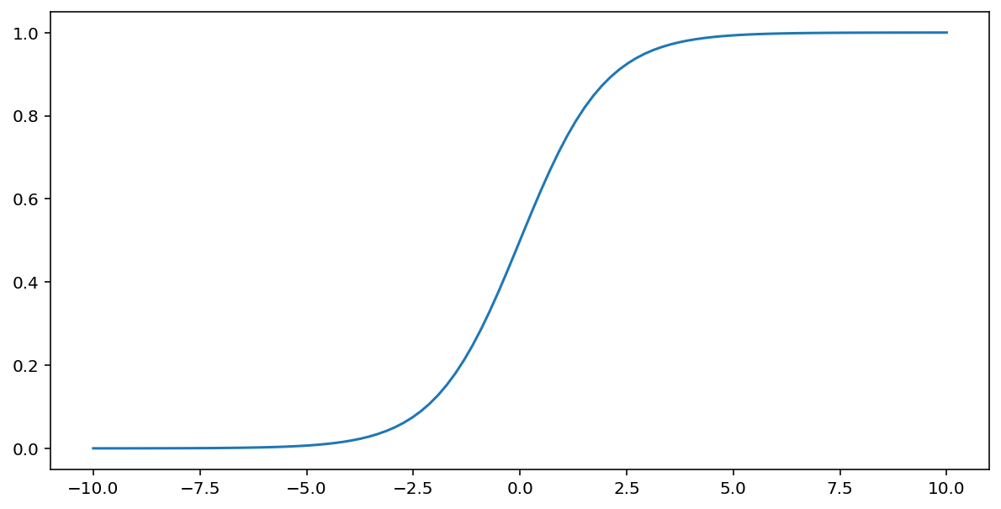
Sigmoid Function

Slide 10
Tanh Function
f(x)=tanh(x)
Output range: –1 → 1
Characteristics:
  S-shaped curve, centered at 0
  Stronger gradients than sigmoid for negative inputs
Use case: hidden layers to allow centered outputs

Slide 11
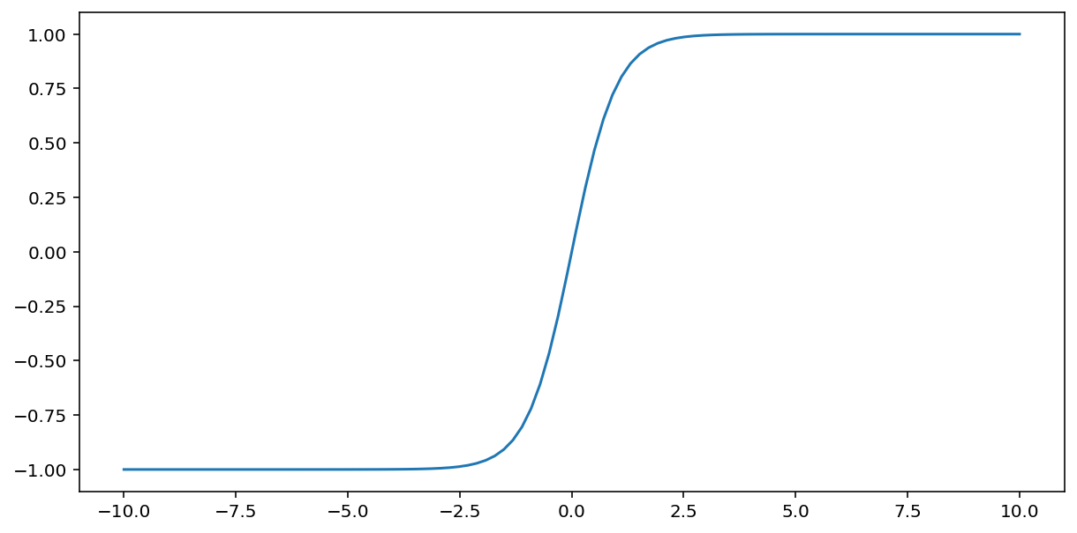
Tanh Function

Slide 12
ReLU Function
f(x)=max(0,x)
Output range: 0 → ∞
Characteristics:
  Simple and fast to compute
  Less prone to vanishing gradient problem
  Works well in deep networks
Use case: most hidden layers in modern networks

Slide 13
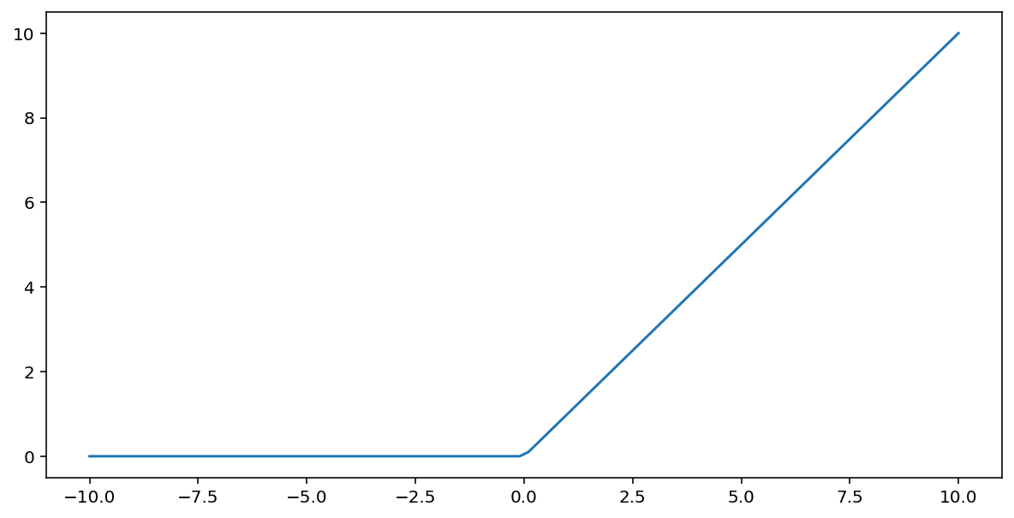
ReLU Function

Slide 14
Training using backpropagation
Most common training algorithm for neural networks
Enables gradient descent for multi-layer networks
Adjusts weights and biases to improve predictions

Slide 15
How Backpropagation Works
Forward pass:
  Input → Hidden layers → Output
  Example: predicted = 0.8, true label = 1.0
Compute error:
  Error = true − predicted = 1.0 − 0.8 = 0.2
Backward pass:
  The algorithm works backward from the output layer to the input layer.
  It finds how much each weight and bias contributed to the error.
  This is done using gradients (derivatives that show the rate of change).

Slide 16
How Backpropagation Works
Update weights:
  New weight = Old weight − learning rate × gradient
Repeat:
  Continue until predictions are accurate

Slide 17
Vanishing Gradients
In deep networks, gradients in early layers can become very small
Causes slow learning or stops the layer from learning
Prevention: use ReLU activation

Slide 18
Dropout Regularization
form of regularization, is useful for neural networks.
Randomly drops neurons during training for one step
Prevents overfitting
Dropout values:
  0.0 → no dropout
  1.0 → drop all neurons (network learns nothing)
  0.0–1.0 → partial dropout, effective regularization

Slide 19
Multi-class classification
One-vs.-All
Uses binary classifiers for each class
Example: classify a fruit image
  Is it an apple?
  Is it an orange?
  Is it a banana?
  Is it a grape?
Works well for small number of classes
Deep neural networks can implement one-vs-all efficiently: each output node represents a class

Slide 20
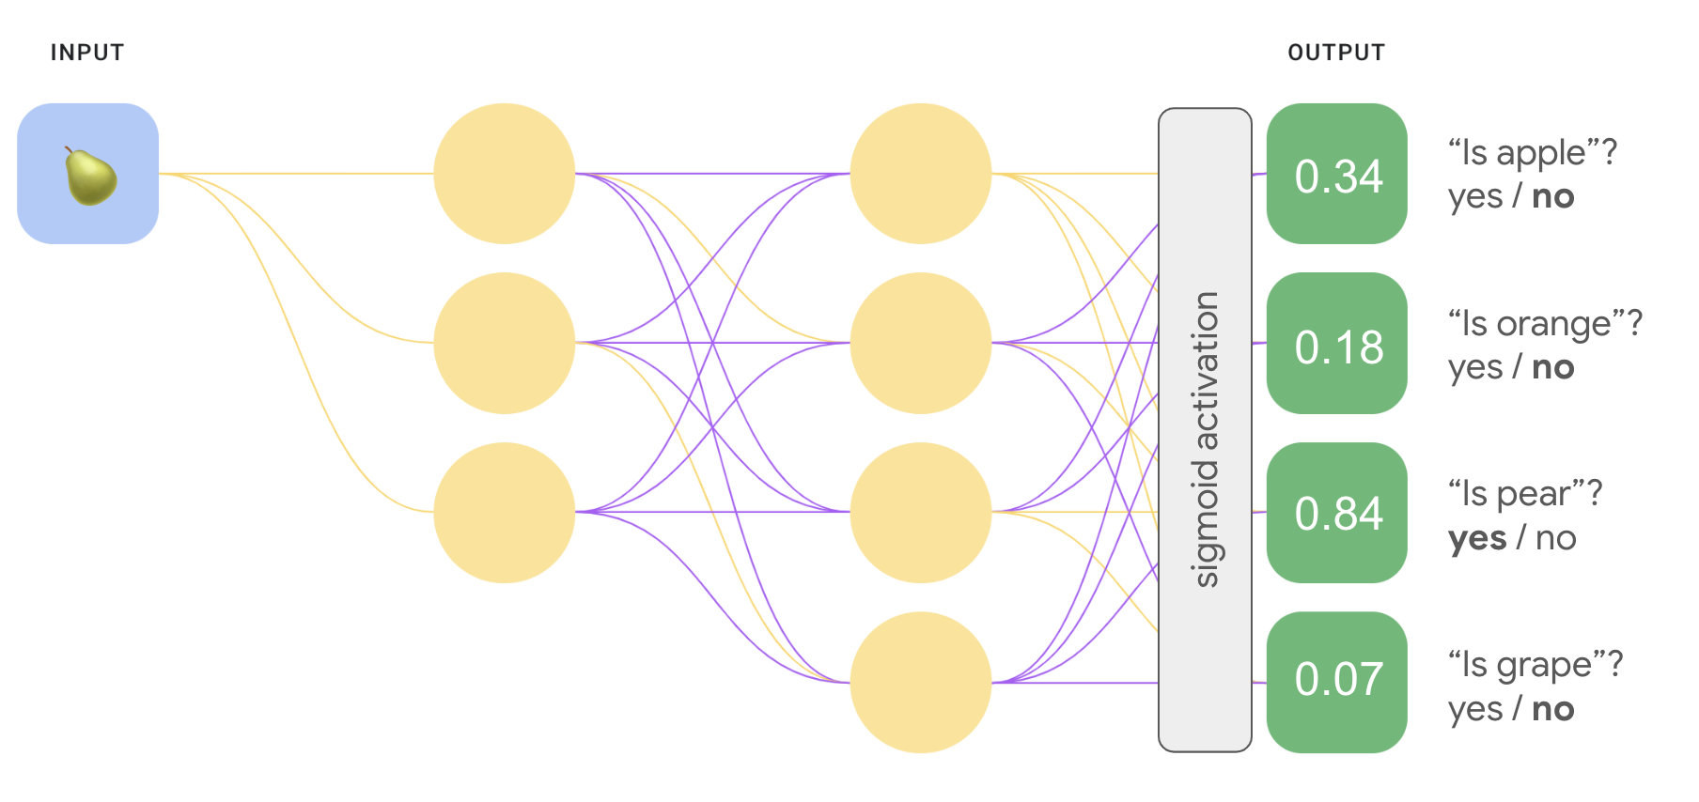
One-vs.-All

Slide 21
Multi-class classification
One-vs-One (Softmax)
Computes probabilities relative to all classes
Changes output layer:
  Sigmoid → Softmax
Softmax function:
  Converts raw outputs (logits) to probabilities
  Ensures probabilities sum to 1
  Outputs are comparable across classes
  Helps training be faster and more stable

Slide 22
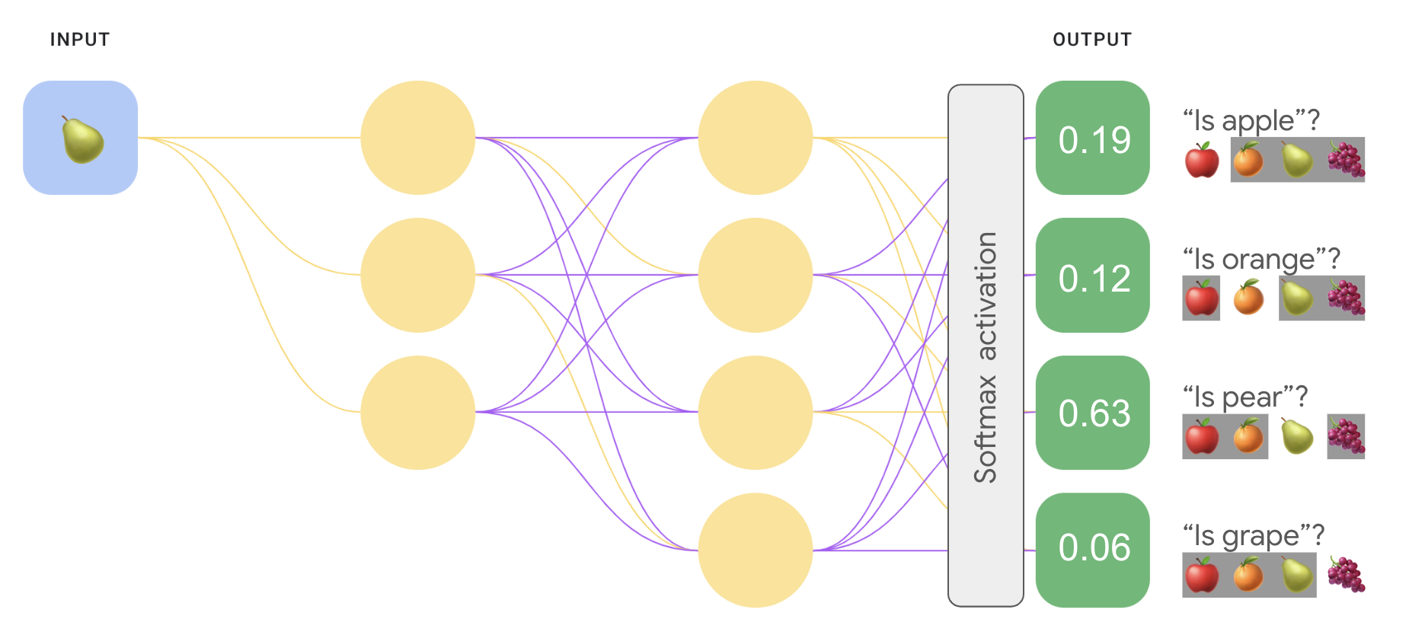
One-vs-One (Softmax)

Slide 23
Single vs. Multiple Labels
Softmax:
  Assumes one label per example (multi-class)
  Model selects most likely class
Multiple Sigmoids:
  For multi-label examples (e.g., image with apples & oranges)
  Each class gets independent probability

Slide 24
Pitfalls of sparse data representations
Too many weights:
  With M features and N nodes, need M × N weights — grows fast.
High data needs:
  More weights → more data required to avoid overfitting.
Expensive computation:
  Training and inference take more processing power.
High memory use:
  Large weight matrices consume a lot of memory.
Hard to deploy:
  Big models don’t fit well on small or edge devices.

Slide 25
What Is an Embedding?
embedding is a vector representation of data.
Each item (word, image, category, etc.) becomes a point of numbers like [0.8, 0.6].
These points live in an embedding space — a mathematical space where:
  Close points → similar items
  Far points → different items
Helps models capture relationships and reduce data size.
Embeddings are for word, but the model learns them based on meaning

Slide 26
Why Use Embeddings
Embeddings = compact, dense representations that:
  Reduce weights, data needs, computation, and memory
  Work efficiently even with many categories
One-hot encoding: simple but inefficient for large feature sets.
Embeddings: smaller, smarter, and capture relationships between categories.

Slide 27
Why Use Embeddings
Method | Example | Meaning
One-Hot | Cat → [1, 0, 0]Dog → [0, 1, 0]Car → [0, 0, 1] | Only shows existence (0/1), no relationship
Embeddings | Cat → [0.8, 0.6]Dog → [0.7, 0.5]Car → [0.1, -0.9] | Captures similarity (Cat & Dog close, Car far)

Slide 28
Embedding Space
Visualizes how items relate:
Each new dimension adds more meaning (e.g., sweetness, liquidness).
Real-world models use hundreds of dimensions (e.g., 256, 512).
Each dimension is not directly human-understandable, but the model learns useful patterns.

Slide 29
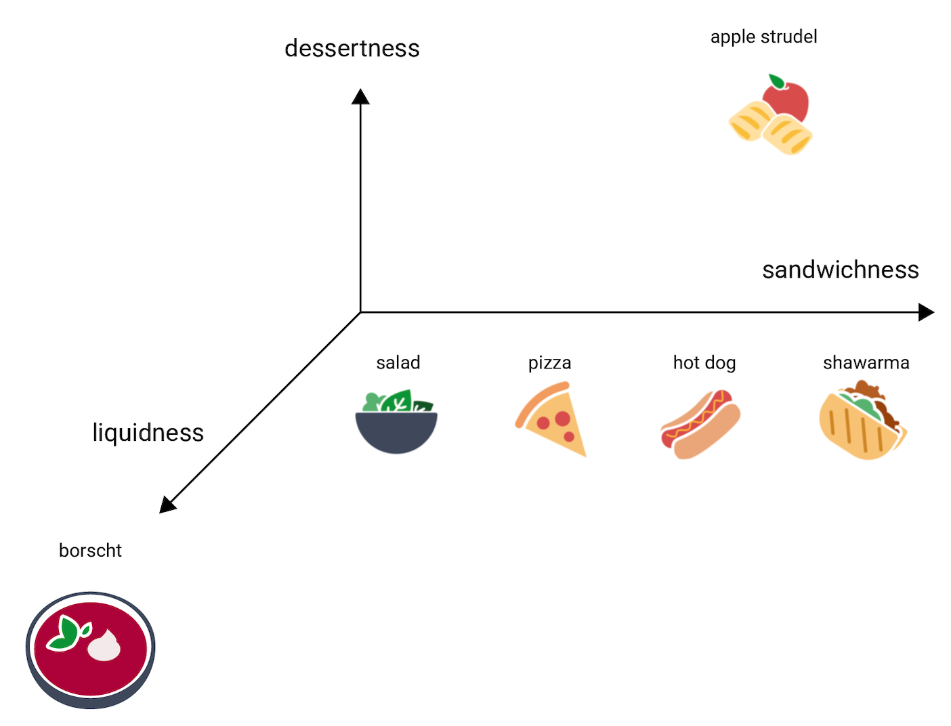
Embedding Space

Slide 30
Static Embeddings
Static embeddings → each word has one fixed vector.
Learned by predicting context (surrounding words).
Words in similar contexts get similar embeddings.
Example:
  “They rode a burro…” vs. “They rode a horse…”
  → burro and horse vectors become close.
word2vec is the most known model for static embeddings.
**word2vec** :
  technique for creating vector representation of words
  will learn how to represent words as high dimensional vectors

Slide 31
Skip-Gram Model
Trains by predicting context words from a target word.
Example: Given “cat,” predict nearby words like “pet” or “fur.”
More skip-grams → better learning, but training takes longer.
After training:
  The weights between input and embedding layer form the embedding matrix.
  Each word’s vector = that word’s weights.

Slide 32
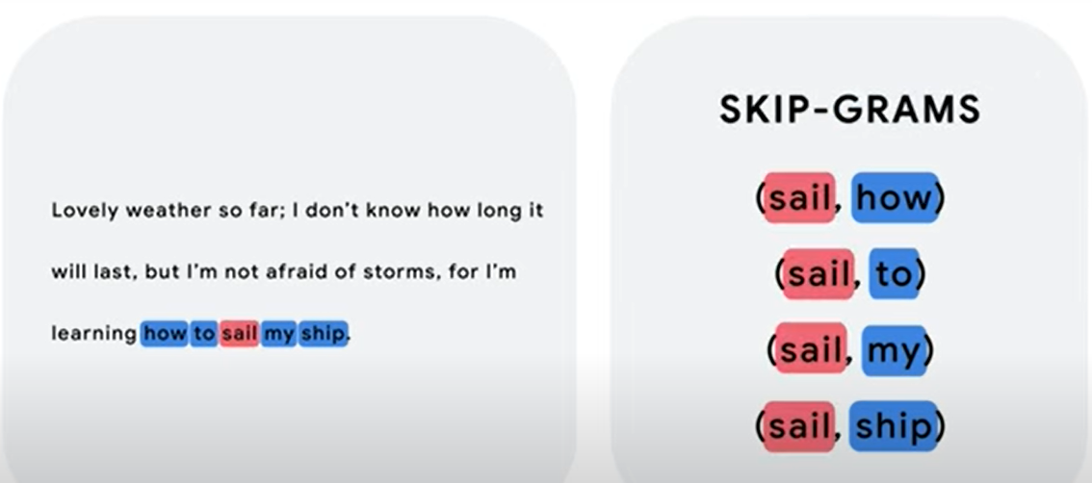
Skip-Gram Model

Slide 33
Static vs. Contextual Embeddings
Type | Description | Example
Static | One fixed vector per word | “Orange” = same vector in all contexts
Contextual | Vector changes with sentence context | “Orange juice” ≠ “orange color”
Limitation of static: can’t handle multiple meanings.
Contextual: adapts dynamically using surrounding words.

Slide 34
Contextual Embeddings in Practice
Transformers
  Look at all words at once to understand meaning.
  Use self-attention to find which words are most important to each other.
  Use positional embeddings to remember the order of words.
  Create a special vector (embedding) that represents the whole sentence.

Slide 35
Obtaining embeddings
High-dimensional data can be compressed into fewer dimensions while keeping important patterns.
This helps create simpler, faster, and meaningful representations (embeddings).
Example:
  PCA (Principal Component Analysis) reduces correlated features into fewer combined dimensions.
  Has even been used to create word embeddings from bag-of-words data.

Slide 36
Training Embeddings in Neural Networks
Can train embeddings directly as part of a neural network.
Add a hidden layer (called an embedding layer) with d nodes → defines embedding dimensions.
During training:
  The network learns vector values that represent input items (like words or foods).
  These embeddings are optimized automatically through backpropagation.
Result: custom embeddings tuned for your specific task.

Slide 37
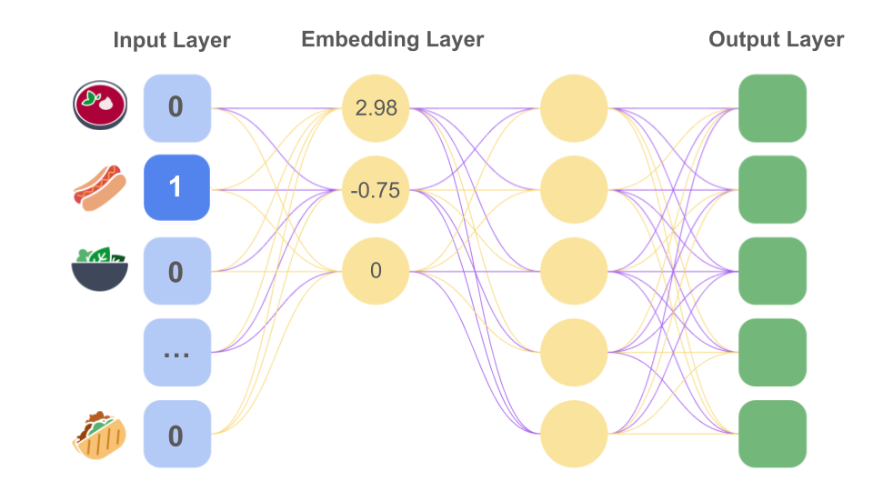
Training Embeddings in Neural Networks

Slide 38
Language Models
Learn how language works by studying lots of text.
Predict the next word (token) based on previous words.
Example: “I want to eat” → “pizza”, “food”
Use tokens (small text units like words or subwords).
Subword tokenization breaks words into smaller parts:
  unwatched → un + watch + ed
  cats → cat + s
Helps the model understand new or rare words.
Used in text, images, and audio models.

Slide 39
N-gram Models
Predict words based on the previous (N−1) words.
Examples:
  2-gram: “you are”
  3-gram: “you are very”
Example: “orange is” →
  “ripe” (fruit) or “cheerful” (color)
Limit: small N = short context → many mistakes
Large N = too rare → unreliable

Slide 40
Context
Context = words before or after the target word.
Helps choose the right meaning (e.g., “orange” = fruit or color).
N-gram models have limited context.
Bigger context → better understanding but harder training.

Slide 41
Recurrent Neural Networks (RNNs)
Learn from sequences of words (one at a time).
Remember important info, forget the rest.
Can understand context across sentences.
Still limited for very long texts.
Struggle with vanishing gradient → hard to learn long dependencies.
Modern LLMs are better — they see the whole text at once.

Slide 42
What's a large language model
Understand longer context and meaning
Contain far more parameters than older models
Make smarter, more accurate predictions

Slide 43
What Is a Transformer?
Core architecture behind modern LLMs
Uses Encoder + Decoder structure
  Encoder: Understands the input text
  Decoder: Generates the output text
Example:
  English → Encoder → Intermediate meaning → Decoder → French

Slide 44
Compression
Method / Architecture | Used In | How It Works | Limitations
N-gram models | Early LMs | Use word frequency counts (e.g., “I am” → “happy”). Predict next word statistically. | Very limited context (only last few words).
Recurrent Neural Networks (RNNs) | Later LMs | Read text word by word, remember previous words using internal memory. | Forget long-term context (vanishing gradients).
LSTM / GRU | Improved RNNs | Special RNNs that can remember longer context. | Still slow and limited for very long texts.
Transformers | Modern LLMs (e.g., GPT, BERT) | Use self-attention to look at all words at once, not just sequentially. | Require high computational power.

Slide 45
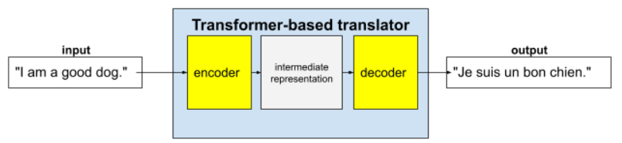
What Is a Transformer?

Slide 46
Encoder-only Models
Read and understand text
Converts text → meaningful embeddings
  Finding meaning or intent
  Predicting missing words
Example:
  The cat is on the ___” → “mat”

Slide 47
Decoder-only Models
Generate text word by word
Looks at previous words
→ predicts next
Used for:
  Writing stories, chat replies, code
Example:
  “Once upon a time,” → “there was a small village by the sea.”

Slide 48
Intermediate Representation
It’s how the Transformer understands the input before giving an answer.
The encoder changes each word into numbers (vectors) that show meaning and context.
Example:
  “I” → [0.2, -0.4, 0.6, …]
  “am” → [-0.1, 0.5, -0.3, …]
  “hungry” → [0.7, -0.1, 0.8, …]
These numbers together are the model’s understanding of the sentence.
The decoder then uses this information to generate the output, like a translation or a response.

Slide 49
Self-Attention
Each word looks at all other words to understand meaning
Learns which words are most important
Example:
  “The animal didn’t cross because it was tired.”
    “It” attends to “animal.”
Bidirectional = looks before and after (encoder)
Unidirectional = looks only before (decoder)

Slide 50
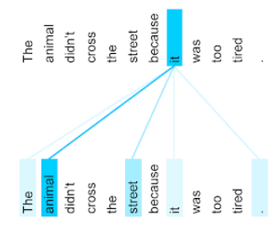
Self-Attention

Slide 51
Multi-Head, Multi-Layer Attention
Multi-head: Each head focuses on different relationships (grammar, meaning, reference)
Multi-layer: Stacked layers give deeper understanding
  Early layers → grammar
  Middle → meaning
  Deep layers → reasoning

Slide 52
Fine-tuning
training a foundation LLM on specific examples to make it better at one task
Uses task-specific examples (hundreds to a few thousand)
It doesn’t need a lot of data — sometimes only a few hundred examples.
Standard fine-tuning: Updates all model parameters → computationally expensive
Parameter-efficient tuning: Updates only some parameters → faster, cheaper

Slide 53
Distillation
Creates a smaller, faster model from a large LLM
Large LLMs use huge computational and environmental resources, though many parameters are unnecessary for specific tasks.
Uses a teacher-student approach:
  Teacher model labels data
  Student model learns from those labels
Benefits:
  Faster predictions
  Fewer resources needed
  Slightly less accurate than the large model
Example: Large toxicity model labels data → small model performs real-time moderation

Slide 54
Prompt Engineering
Guides the LLM to produce desired output
One-shot: 1 example given
Few-shot: Multiple examples given
Zero-shot: Only instructions, no examples
Does not change model parameters — just leverages pattern recognition

Slide 55
Offline Inference
Also called bulk or static inference
Predictions are precomputed and stored
Useful for tasks not requiring live responses
Example: Google Search precomputed Covid vaccine synonyms for real-time query detection

Slide 56
Summary
Neural Networks:
  Models that learn patterns from data for tasks like prediction, classification, and recognition.
  Structure: Nodes (neurons)/Hidden layers.
  Activation Functions (Sigmoid, Tanh, ReLU.)
  Backpropagation to adjust weights and reduce errors
  Used for multi-class classification through techniques like softmax.

Slide 57
Summary
Embeddings
  Numerical vector representations of data (like words or items).
  Reduce dimensionality and capture relationships or similarities between entities.
  Embedding Space
  Types (Static embeddings vs Contextual embeddings)
  How to Obtain

Slide 58
Summary
Language Models (LMs)
  Predict the next word (token) based on previous words.
  Learn statistical patterns of language from large text data.
  Algorithms (N-gram models/RNNs)\
  Limitations
  These models laid the foundation for LLMs.

Slide 59
Summary
Large Language Models (LLMs)
Advanced models built using Transformers that understand and generate human-like text.
Text generation, translation, summarization.
Category | Techniques
Architecture (how LLMs are built) | Encoder/Decoder, Intermediate Representation, Self-Attention, Multi-head & Multi-layer
Training (how LLMs learn) | Fine-Tuning, Distillation
Usage (how LLMs are used) | Prompt Engineering, Offline Inference

Slide 60
Thanks for your attention!!

